Slide 1
Digital Marketing & Media Services
Enable Responsible Advertising Maximize Brand performance Non-linearly scale RevOps with AI

Slide 2



iOPEX Introduction
Transformation Levers
Data + Process + Ops
Innovating & Optimizing “Cost to Book / Serve”
Enabling “byte size” Agile Transformation
AI
Engineering
Custom AI tools for businesses
AI-powered insights and tools
Predictive modeling and analysis
Turning data into actionable insights
Data & Model Engineering
Data and AI
AI Engineering
AI Operations
Digital Operations
Automating workflows and processes
Integrating AI with existing systems
Manage data, oversee models, and integrate with apps
Fine-tune, evaluate & train LLMs
User-centric AI solutions design
Digital Workflow & Automation
GenAI-Copilots
BeSpoke Applications
Cybersecurity
Digital Marketing & Media Services
Enterprise Product Support
Customers Experience Services
Digital Health Services
Automating complex and repetitive tasks
AI-driven process optimization
Hyper-
Automation
Business Functions
Industries
Outcomes
Revenue
Product Ops
Telecom
Media
Enhance Cx, Ex , Px
AI-powered threat detection
Automating cybersecurity processes
Marketing
Cloud Ops
Hi-Tech
Retail
Non-Linearly Scale Operation
Cybersecurity
Finance
Security Ops
Generate Friction free revenue
Customer Service
Supply Chain
Innovate Continuously
AI in cloud operations
Hybrid cloud integrations
Cloud
Engineering
Our AI-driven operations automate tasks, optimize decision-making, and improve productivity, allowing businesses to achieve cost-effective, agile, and scalable operations while maintaining long-term excellence

Slide 3







iOPEX Outcomes To Business
We deliver byte size agile transformation with an insight-led experience architecture
3500+
Employees
1000+ Agentic AI
$2.5 Bn
Cost Transformation
$1.2 Bn
Frictionless Revenue Enabled
72+
Customers
50 of Fortune 100
Outcome Driven company, leading innovation and EBIDTA savings for our customers
6 Locations
US, Canada, UK, EU
India, Philippines

Slide 4
Digital Marketing & Media Services - Media Monetization
Global Service Layer for Retail / Commerce Media | Publishers | CTV | Ad-tech | Brands
1. Monetize
2.Execute
3.Innovate
Enable Responsible Advertising
Maximize Brand performance
Scale Non-Linearly with AI
Consult & Enable Advertising with 1st party data
Build Customer data platforms
Audience Segmentation in DMPs
Ad Stack Setup & Integrations
Onsite
Offsite
Instore
Ad Experience Testing
Alpha | Beta | GA launches
Sales & Order Management
Reporting & Analytics
Managed Service
Advertising Operations
Creative Operations
Data & Measurement Operations
Sales & Billing Operations
Tech Operations
Self Service
Customer Onboarding
Customer & Technical Support
Customer Success
Trust & Brand Safety
Ad-Policy Review
Content Moderation
System Modernization & Integration
Lead/Opportunity Management
Order Management
Campaign Management
Data Integrations
Business Process Automation
Campaign Creation
Trafficking & QA
Reconciliation & Actualization
GenAI
Media Performance & Planning
Ideate to Create
Billing & Contracts
Build Ad Stack
Revenue Operations
Media Labs
$6.8B
110K+
3.5M+
200K+
15K+
100+
4X
Media
Spend Managed
Campaigns
Launched
Creative
Trafficked
Creative
Designed
Brands
Served
Platform
Transformation
Return on Ad Spend Across campaigns

Slide 5
Managed Services - Revenue Operations
Revenue
Data
Creative
Technology
Excellence
Advertising Operations
Measurements & Insights Operations
Creative Operations
TechOps
BizOps
E2E management of campaign operations - onsite and/or offsite
Plan, Setup, Traffic, Optimize, Report, Bill & Account Management
Data extraction, audience management, campaign and market study
Data Analysis, Insights, Visualization
Building any form of creative from concept till creative optimization
Display, Video, Email, Native, Social, DCO
Integration, implementation & customization of business and tech solutions
Ad server, SSPs, DSPs, CDP, Ad surfaces UX, Dashboards
Strategy & Consulting, Process Excellence, Efficiency & Scale, Design & Presentation
Leadership Advisory & Strategies, Market Study, Business Presentation, Optimization
Retail / Commerce Media | Publishers | CTV | Ad-tech
Grow Revenue & Optimize Operations
Onsite | Offsite | In-store | Outdoor
$6.8B
110K+
3.5M+
200K+
15K+
100+
4X
Media
Spend Managed
Campaigns
Launched
Creative
Trafficked
Creative
Designed
Brands
Served
Platform
Transformation
Return on Ad Spend Across campaigns

Slide 6
Advertising Operations
Sales Operations
Revenue Enablement (Omni Channel)
Finance Operations
v
Sales Enablement
Direct & Programmatic
Sponsored Products
Billing Operations
Sales media kit
Credit Check
Opportunity Management
Sales Pipeline Updates
Revenue forecasting
Contract Management
Account On/Off boarding
Churn Analysis
Audiences Generation
Audience Segmentation
Media Planning
Media Buying
Prospecting & Retargeting
Campaign Setup
Creative Trafficking
Pixel Implementation
Creative Screengrabs
Campaign QA
Campaign Wrap decks
Campaign / Bid Optimization
Deal ID Management
Domain Whitelisting/Blacklisting
Reporting & Analytics
SKU Management in Seller Central & Supplier Central
Keyword Analysis
Conquesting Keywords Check
Advertiser Onboarding
Campaign Set up
Campaign Trafficking
Creative Screengrabs
Creative Ad Policy Review
Campaign Optimization
Keyword Bidding
Digital Shelf optimization
Reporting & Analytics
Delivery Reconciliation
Actualization & Billing
Invoicing
Accounts Receivables Mgmt.
Yield Management
Inventory Forecasting
Inventory Tiering
Inventory Calendaring
Pricing Management
Lockout discounts, Pricing and Rate card roll outs
Yield Analytics & Insights
Revenue Optimization
Account Management
Account Strategy
Enterprise
Mid & Long Tail
Brand Spend Research
Customer Success & Adoption
Upsell / Cross Selling
Standard SLAs
2 Hours - Acknowledge request
4 Hours - Priority tickets
8 hours - Standard SLA
Quality - 97%
Escalation - Less than 3%
Handle Time - 20 Mins per Campaign
SLA - 1 Business day
Reporting Accuracy - 98%
SLA - 1 Business day
Quality - 98%
SLA - 1 Business day
Accuracy - 98%

Slide 7

Measurement & Insights Operations
Data Query - Extraction - Cleansing - Synthesizing - Reporting - Visualization - Insights
Measurement Operations
Pre Campaign Analysis
Audience Analysis
Mid Campaign Analysis
Performance
Post Campaign Analysis
Upsell
Reporting & Insights
Audience Strategy & Activation
Building new audience groups
Audience Segmentation
Audience study & insight
Forecasting
Campaign Reporting
Daily Pacing reports
Campaign performance report
Performance trend insights
Campaign Insights
Wrapdecks - MBR, QBR
Mid campaign performance insights
Post campaign report
Data extraction
Data Validation
Tableau Dashboards
Creation
Maintenance
Report Management
Inventory
Revenue realization
3rd Party discrepancy
Measurement Tag validation
Daily Pacing
Post campaign
MBR & QBR
Wrap Decks
User Journey Mapping
Tracking pixel data and mapping user journey
Building personas
Site analysis
Campaign Monitoring
Good performance, Good pacing
Good performance, Bad pacing
Bad Performance, Good Pacing
Bad Performance, Bad pacing
Post Campaign Reports - PCR
Campaign Metrics
Trend
Similar campaign comparison
Industry comparison
By campaign, placement, creative, channel, demography, geo reports and insights
Go to market plan
Observations and recommendations
Market Research
Competitor analysis
Trend analysis
Key Campaign Metrics
Visibility (Impressions, Clicks)
ROAS
Orders
Targeting
Budgets
Dayparing
Pacing
Integrations / Connections
Building data connecters
Building dashboards
Sample Reports
Brand Insights
Daily Pacing Report
Campaign Performance Report
Post Campaign Analysis

Slide 8



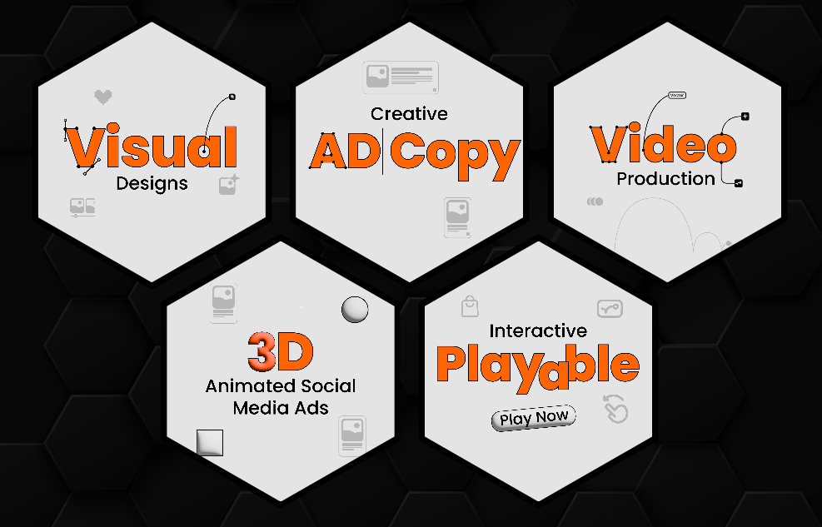
Creative Operations
Our Retail & Content Services
Craft persuasive and concise ad text tailored to captivate and compel target audiences.
Develop visually compelling advertisements optimized for digital platforms and brand resonance.
Create engaging and interactive ad formats, including videos and animations, to enhance user experience.
Generate real-time personalized ad elements, adapting to user behavior and preferences dynamically.
PROGRAM MANAGEMENT
CENTRALIZED OPS Single communication point for all operations makes it easier for clients
Ad Copy Services
Ad Design & Production
Rich Media
Dynamic Ad content
Design visually appealing and user-friendly digital storefronts or product pages for optimal online shopping experiences.
Develop interactive Microsoft ads that users can engage with, providing an immersive and entertaining experience.
Craft ads with direct shopping functionality, allowing users to seamlessly make purchases within the ad experience.
Implement cutting-edge 3D, Augmented Reality (AR), or Virtual Reality (VR) elements for immersive and innovative digital experiences.
Storefront / Product Page Design
Playable Microsite
Ads
Shoppable Ads
3d / AR / VR
ART DIRECTION TEAM
IDEATION Generate campaign ideas and new and relevant creative concepts
Creative Types
Display
Text & Image Ads, Rich Media Ads, Dynamic Ads, Native Ads, Trueview & Lightbox Ads
Sample Portfolio
Native & Social
https://iopexcreatives.pages.dev/
Sponsored Ads, In-feed promoted content, Native Search Ads, In-Feed Social Ads
DESIGN & DEVELOPMENT TEAM
Video
In-stream Ads, Out-stream Ads, VAST
CREATIVE DESIGNERS The team designs all type of creative collaterals from a simple static design to a 3D animated video.
DOOH, Voice, CTV
Dynamic Signage, Data feed ads, DAAST, Native Audio, recorded audio, In-stream Video, Home screen placement ads
Localization
Video Assets
Playable / Microsites
Iterations
Turn Around Time
1 Business Day
5 Business Days
7 - 10 Business Days
Unlimited

Slide 9
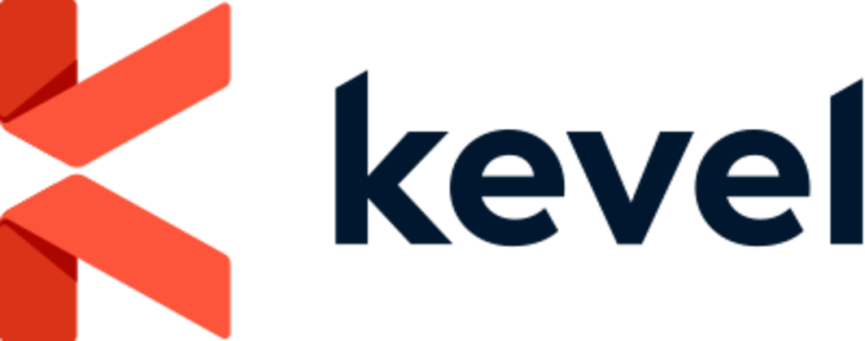




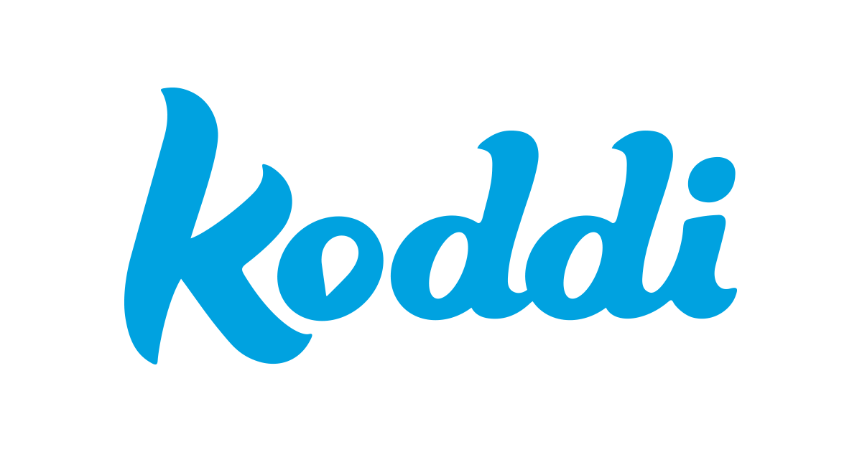
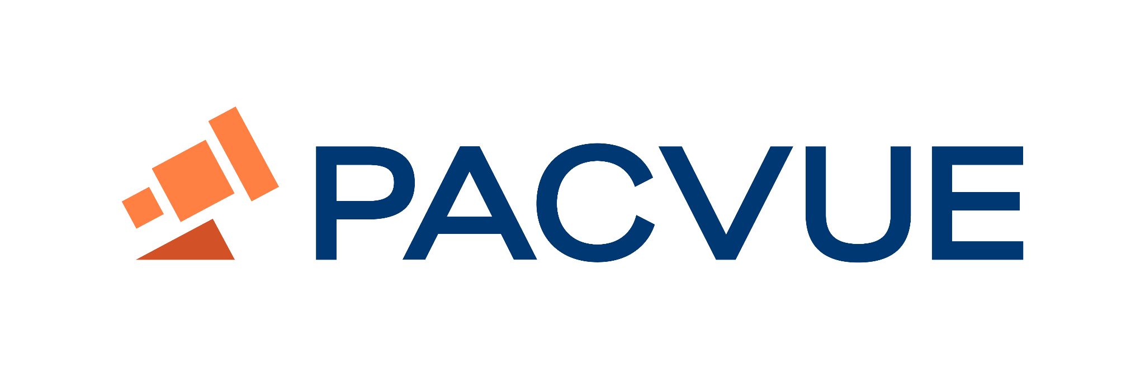



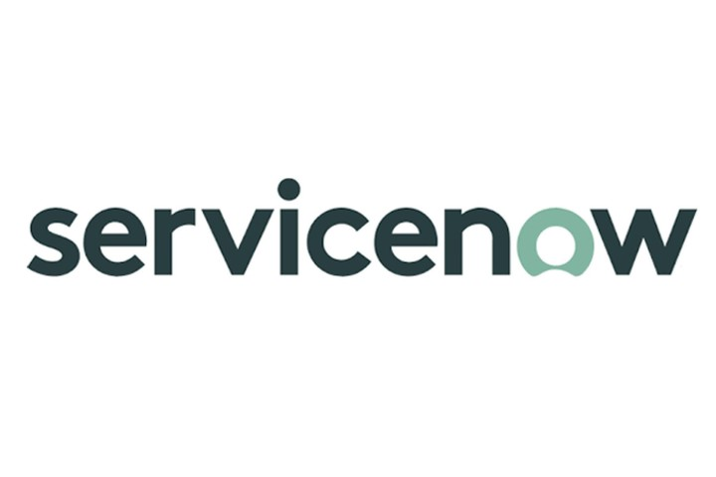




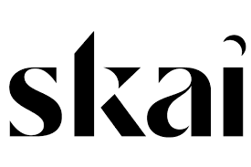










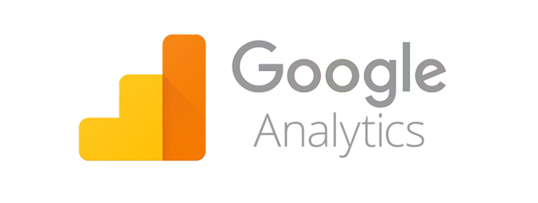
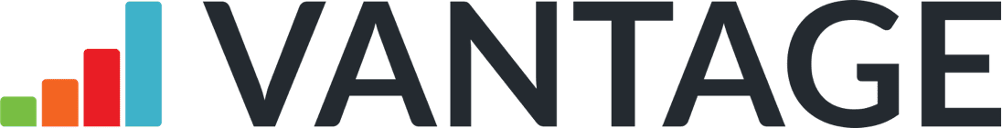




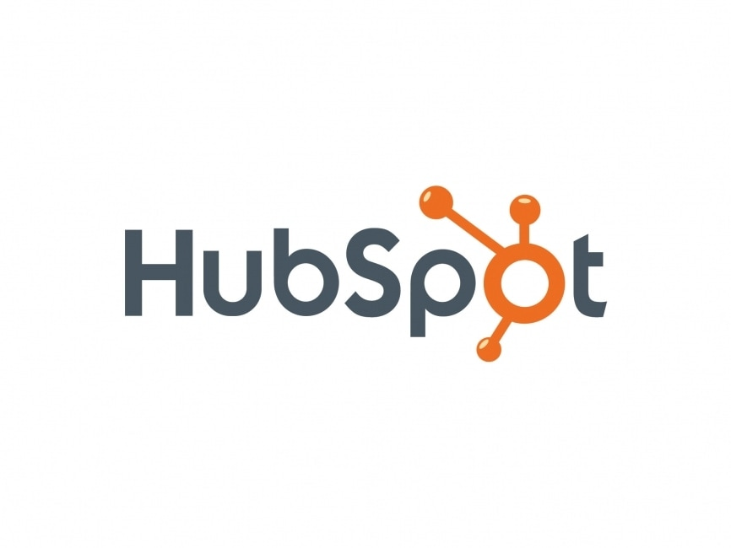



Managed Services - Platform & Skills Expertise
Retail Media
SSP / DSP
Business Systems
Business Consultants | Tech Consultant | 1st Data Specialist | CDP/CMP Specialist | Ad Stack Engineers | UX Consultants Campaign Managers | Ad Trafficker | Data Analyst | Insights Analyst | TechOps Engineer | Billing Specialist

Slide 10
Onboarding Plan: Pilot Phase (0-60 Days)
Phase 1 Pilot Kick-Off & Team Onboarding
Phase 2 Training & Knowledge Transfer
Phase 3 Shadowing & Reverse Shadowing
Phase 4 Go-Live Execution
Scope Definition & Goal Alignment – Define engagement model, success criteria, and campaign execution framework.
SOP Finalization – Develop process maps, escalation matrix, and workflow documentation.
Team Hiring & Role Definition – Recruit SMEs, QA analysts, and campaign managers, mapping responsibilities.
Credential Set-Up & System Access – Ensure secure access to ad platforms, reporting tools, and quality control dashboards.
Success Metrics:
✅ SOP completion & system setup: 100% ✅ Team onboarding: 100% ✅ Initial knowledge assessment: >85%
Train the Trainer – Senior specialists conduct hands-on learning on campaign setup, targeting, bidding, and creative QA.
Use Case Training – Practical simulations of real-world campaigns based on client’s historical data.
QA & Troubleshooting – Deep dive into campaign error detection, budget pacing, and compliance audits.
Client Shadowing – Observe client workflows, analyze historical campaign performance, and document key decision-making frameworks.
Reverse Shadowing – Team takes over execution while client provides oversight, refining SOP adherence and decision accuracy.
Phased Responsibility Transfer – Begin with simple test campaigns, gradually moving to complex, high-budget setups.
Real-Time Performance Monitoring – Implement QA checkpoints to ensure campaign accuracy and adherence to KPIs.
Client Sign-Off & Handover Completion – Achieve performance benchmarks and finalize steady-state transition.

Slide 11
Onboarding Plan: Transition to Scale & efficiency (60-360 Days)
Phase 1 Steady State
Phase 2 Continuous Improvement
Phase 3 Operational Efficiency
Support Excellence – Strengthen support teams with dedicated QA & SMEs to drive performance consistency.
Technical Support Expansion – Establish dedicated leads for campaign troubleshooting and advanced optimization.
Operational Excellence – Implement transparent workflows with clear process ownership.
Governance & Performance Monitoring – Conduct weekly reviews and dashboard tracking for proactive issue resolution.
Process Efficiencies – Identify time-consuming manual tasks and optimize them for faster execution.
System Efficiencies – Enhance product functionalities, streamline reporting & analytics tools.
Knowledge Enhancement – Promote cross-skilling across teams, increasing versatility and reducing dependencies.
AI-Driven Optimization – Implement automated recommendations for campaign bidding, audience targeting, and pacing.
Quick Fix Automation – Implement small-scale automation for repetitive tasks, reducing resource dependency.
Long-Term Automation Strategy – Discover and deploy advanced automation for complex workflows and campaign execution.
Non-Linear Growth Approach – Scale operations without proportionally increasing FTEs through AI and machine learning solutions.
Cost Efficiency Tracking – Maintain an operating cost between 5-6% of total ad revenue through automation and efficiency gains.

Slide 12
Engagement beyond Pilot Phase - Scale & Efficiency
1
Pilot Phase
2
Steady State
3
Continuous Improvement
Operational Efficiency
4
30 Days
60 Days
90 Days
120 Days
150 Days
180 Days
210 Days
240 Days
270 Days
300 Days
330 Days
360 Days
390 Days
420 Days
450 Days
480 Days
Total Campaigns: 1000
Brands: 90
Budget Handled: ~ $25M
Total Campaigns: 3000
Brands: 250
Budget Handled: ~ $60M
Total Campaigns: 6500
Brands: 550
Budget Handled: ~ $100M
Total Campaigns: 10,000
Brands: 1200
Budget Handled: ~ $250M
Maintaining Operating cost at 5% to 6% against the total Ad Revenue
Pilot Phase
Steady State
Continuous Improvement
Operational Efficiency
Pilot Kick Off - Team Onboarding
Scope - Campaign Setup, Creative QA, Optimization etc.
SOP Finalization
Hiring the core team
Credential Set up
Training & Go-Live
Train the trainer
Assessment & Sample use cases
Go-live from simple to complex cases
Support Excellence
Strengthening support with dedicated QA and SMEs
Driving technical support through dedicated leads
Operational Excellence
Transparent & efficient operations
Weekly reviews and performance dashboard
Process Efficiencies:
Identifying time-consuming tasks for optimization
System Efficiencies:
Drive product enhancements and efficiencies
Knowledge enhancement:
Enhance skills of analysts and promote cross-skilling across tasks & functions
Quick Fix Automation -
Identify & improve efficiency per resource with quick fix automation.
Planned Long term automation
Discover and drive automation for complex workflows
Non Linear Growth
Do more with less FTEs. Focus on driving automation

Slide 13

Customer Proof Point - 1
Enabling CPGs & Food Chains To Effectively Manage Their Shopper Budget Spend – Global Rider / Delivery App
Unified Technology Stack Implementation
Client:
Our client is a leading global technology platform revolutionizing urban mobility and food delivery. Operating in numerous cities worldwide, the company connects consumers with a vast network of transportation and delivery options through its user-friendly mobile app.
10k+ Creatives trafficked
The Challenge:
Disparate client teams were working on ad tech implementation and scaling operation function without strategic coordination. They required a single partner with deep expertise in advertising technology, operations and book to bill systems to act as a Global Service Layer
$1BN+ Campaign budget handled
10x Return on Ad Spend
30% Revenue increase via upsells
The Solution:
Ad-Stack Solutioning
Managed Services
[Revops]
Business Systems
24% Increase in productivity
Ad Server Integration: Implemented GAM (for managing robust product set).
Customized Migration Plan: Tailor made to ensure a seamless transition of campaigns with 100% accuracy.
Dedicated Support Team: Assembled a specialized team of ad technology experts to oversee and execute.
Solution Engineering: Support enabled for ongoing product issues, launches and campaign maintenance.
Global Operations Team: Accelerated revenue from $200 Million to $1 Billion.
Follow the sun (24/7): Support enabled for seamless on time campaign launches.
Cross Trained Resources: RevOps | CreativeOps | AdOps | MeasurementOps | SalesOps
Upsell / Cross sell: Dedicated tiger team focusing on incremental revenue and ROAS
Book to Bill Platform: Streamlined and implemented system for seamless campaign execution from planning to order to invoicing;
Leads Management - Salesforce
Order management - Placements.io
Ticketing - JIRA
Reporting - Tableau
Contracting - DocuSign
Process Automation - RPA
100% Coverage across time zones
80% Repetitive tasks automated
30% efficiency gain

Slide 14
Customer Proof Point - 2
Enabling CPGs & Consumer Electronics To Effectively Manage Their Shopper Budget Spend – Global Retailer
98% Campaign Migration Success Rate
Client:
A prominent global retail leader, known for its extensive network of stores and a diverse product range, including groceries, electronics, and household goods. With a strong e-commerce presence, they are a key player in the retail industry.
$400MN Active campaigns moved without issues
The Challenge:
A client recognized the need to enhance its advertising capabilities by moving away from a traditional agency partnership model. This transition required the establishment of a robust, in-house ad server to allow brands and sellers to easily manage their campaigns. The client also required a dedicated operations team to effectively support this new framework.
5k+ Creatives trafficked
10x Return on Ad Spend
25% Revenue increase via upsells
The Solution:
Ad-Stack Implementation & Migration
Managed Services
[Revops]
Self Services
98% API Resolution Rate
Campaign Migration: Owned the complete implementation and migration of existing campaigns to client’s DSP.
Data Integration: Seamless integration of existing campaign data into the DSP, ensuring continuity and accuracy.
Dedicated Team: Formed to provide managed services, offering continuous support to brands and sellers during and after the migration process.
Campaign Optimization: Continuous monitoring and optimization of campaigns to enhance performance and ROI.
API Connection Support: Assistance with API integrations for brands needing to connect their systems with the DSP, ensuring seamless data transfer and campaign management.
Self-Serve Support for Brands: Ticketing and chat support for brands, allowing them to address all campaign management issues.
98% CSAT on Self Serve support
20% Increase in productivity
25% efficiency gain

Slide 15
Rate Card
Role | Key Value Proposition | Outcome/Impact | Offshore (India) | Onshore (Dallas)
Media Planner | Develops data-backed media strategies to optimize ad spend and ensure maximum campaign reach. | 15-20% cost efficiency in media spend allocation. | $1000 | $1000
Media Buying & Campaign Management | Executes media buys, ensures seamless campaign execution, and optimizes ROI in real-time. | Increased ROI on ad spend, faster execution | $1000 | $1000
Data Specialist | Manages data integration, processes large datasets, and ensures accuracy for business intelligence. | Reduces data processing time by 30%↓ | $1000 | $1000
Reporting Specialist | Generates automated reports and dashboards to provide actionable insights for decision-making. | Accelerates decision-making and reduces manual reporting efforts | $1000 | $1000
Data & Insights Specialist | Analyzes audience trends and campaign performance to refine marketing strategies. | Enhances targeting, leading to higher conversion rates | $1000 | $1000
Creative Designer | Develops high-quality visual assets aligned with brand guidelines and campaign objectives. | Improves engagement rates across campaigns | $1000 | $1000
Billing Analyst | Ensures accurate invoicing, financial tracking, and media spend reconciliation. | Reduces discrepancies and financial risk | $1000 | $1000

Slide 16

Thank you
Q & A

Slide 17
Rate Card
offshore (India)
Onshore (Dallas)
Media planner
Media buying and campaign management
Data Specialist
Reporting Specialist
Data & Insights Specialist
Creative Designer
Billing Analyst

Slide 18
Appendix

Slide 19
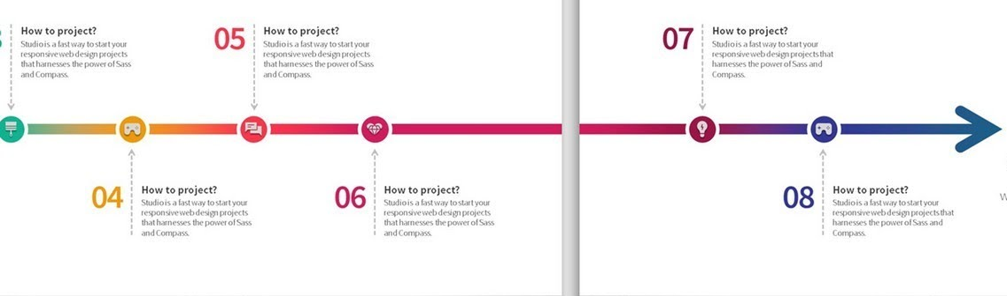
Page 1
Page 2

Slide 20
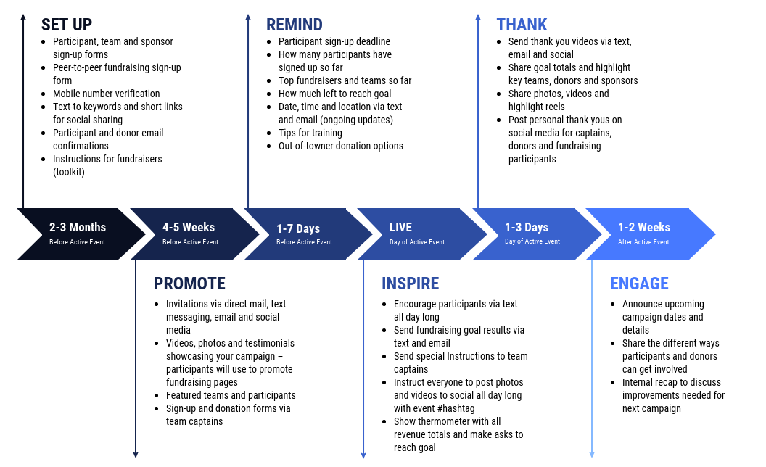
Page 1
Page 2
Cont.

Slide 21
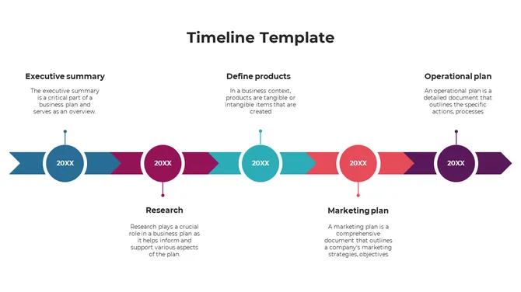
Page 1
Page 2
Cont.

Slide 22
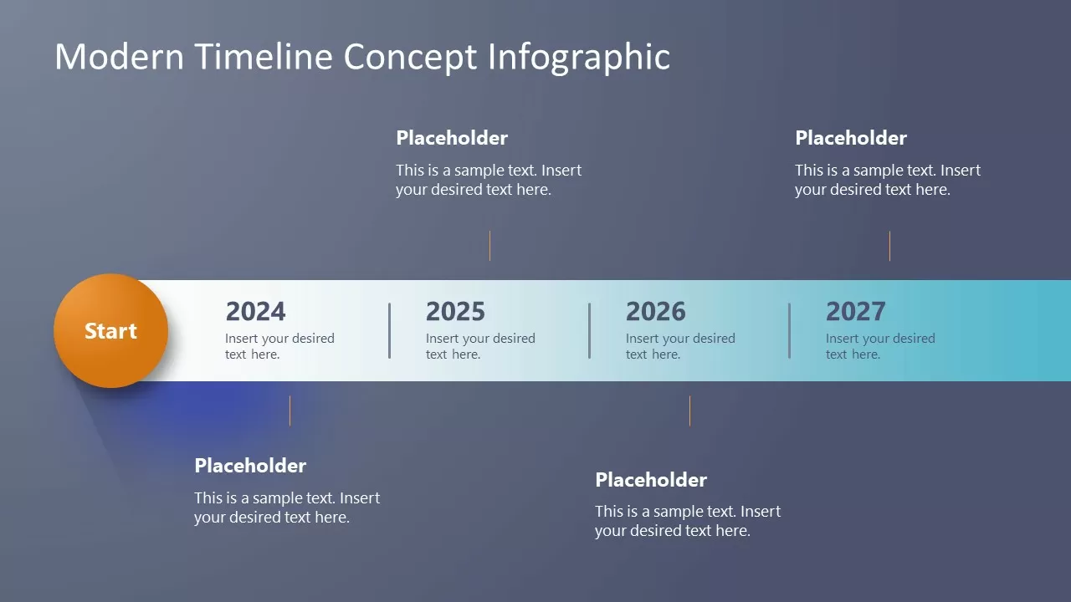
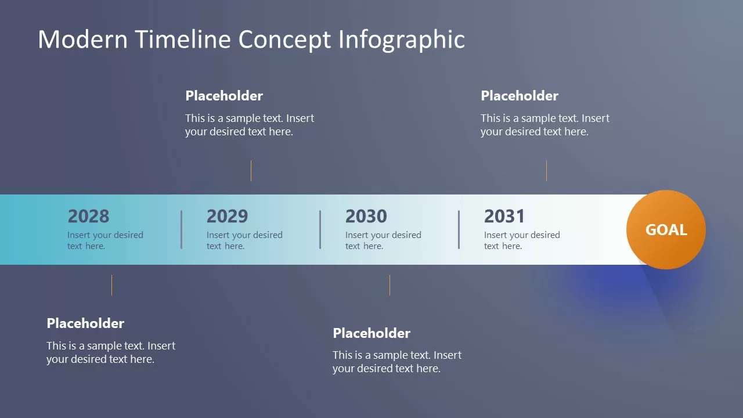
Page 1
Page 2
Cont.

Slide 23
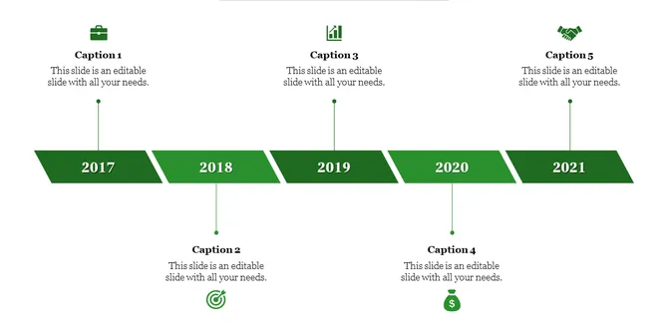
Page 1
Page 2
Cont.

Slide 24
Onboarding Plan: Pilot Phase (0-60 Days)
Phase 1 Pilot Kick-Off & Team Onboarding
Phase 2 Training & Knowledge Transfer
Phase 3 Shadowing & Reverse Shadowing
Phase 4 Go-Live Execution
Scope Definition & Goal Alignment – Define engagement model, success criteria, and campaign execution framework.
SOP Finalization – Develop process maps, escalation matrix, and workflow documentation.
Team Hiring & Role Definition – Recruit SMEs, QA analysts, and campaign managers, mapping responsibilities.
Credential Set-Up & System Access – Ensure secure access to ad platforms, reporting tools, and quality control dashboards.
Train the Trainer – Senior specialists conduct hands-on learning on campaign setup, targeting, bidding, and creative QA.
Use Case Training – Practical simulations of real-world campaigns based on client’s historical data.
QA & Troubleshooting – Deep dive into campaign error detection, budget pacing, and compliance audits.
Client Shadowing – Observe client workflows, analyze historical campaign performance, and document key decision-making frameworks.
Reverse Shadowing – Team takes over execution while client provides oversight, refining SOP adherence and decision accuracy.
Phased Responsibility Transfer – Begin with simple test campaigns, gradually moving to complex, high-budget setups.
Real-Time Performance Monitoring – Implement QA checkpoints to ensure campaign accuracy and adherence to KPIs.
Client Sign-Off & Handover Completion – Achieve performance benchmarks and finalize steady-state transition.
Success metrics
Campaign performance: ±5% from baseline
QA pass rate: >95%
Client satisfaction score:
>4.5/5
Response time adherence: >98%
Documentation completeness: 100%
Team capability assessment: 95%+ proficiency

Slide 25
Onboarding Plan: Pilot Phase (0-60 Days)
Phase 1
Pilot Kick-Off & Team Onboarding
Phase 2
Training & Knowledge Transfer
Phase 3
Shadowing & Reverse Shadowing
Phase 4
Go-Live Execution
Scope Definition & Goal Alignment – Define engagement model, success criteria, and campaign execution framework.
SOP Finalization – Develop process maps, escalation matrix, and workflow documentation.
Team Hiring & Role Definition – Recruit SMEs, QA analysts, and campaign managers, mapping responsibilities.
Credential Set-Up & System Access – Ensure secure access to ad platforms, reporting tools, and quality control dashboards.
Train the Trainer – Senior specialists conduct hands-on learning on campaign setup, targeting, bidding, and creative QA.
Use Case Training – Practical simulations of real-world campaigns based on client’s historical data.
QA & Troubleshooting – Deep dive into campaign error detection, budget pacing, and compliance audits.
Client Shadowing – Observe client workflows, analyze historical campaign performance, and document key decision-making frameworks.
Reverse Shadowing – Team takes over execution while client provides oversight, refining SOP adherence and decision accuracy.
Phased Responsibility Transfer – Begin with simple test campaigns, gradually moving to complex, high-budget setups.
Real-Time Performance Monitoring – Implement QA checkpoints to ensure campaign accuracy and adherence to KPIs.
Client Sign-Off & Handover Completion – Achieve performance benchmarks and finalize steady-state transition.
Success metrics
Campaign performance
QA Pass Rate
Client satisfaction score
Response time adherence
Documentation completeness
Team capability assessment
±5% from baseline
>95%
>4.5/5
>98%
100%
95%+ proficiency

Slide 26
Onboarding Plan: Pilot Phase (0-60 Days)
Phase 1
Phase 2
Phase 3
Phase 4
Pilot Kick-Off & Team Onboarding
Training & Knowledge Transfer
Shadowing & Reverse Shadowing
Go-Live Execution
Scope Definition & Goal Alignment – Define engagement model, success criteria, and campaign execution framework.
SOP Finalization – Develop process maps, escalation matrix, and workflow documentation.
Team Hiring & Role Definition – Recruit SMEs, QA analysts, and campaign managers, mapping responsibilities.
Credential Set-Up & System Access – Ensure secure access to ad platforms, reporting tools, and quality control dashboards.
Train the Trainer – Senior specialists conduct hands-on learning on campaign setup, targeting, bidding, and creative QA.
Use Case Training – Practical simulations of real-world campaigns based on client’s historical data.
QA & Troubleshooting – Deep dive into campaign error detection, budget pacing, and compliance audits.
Client Shadowing – Observe client workflows, analyze historical campaign performance, and document key decision-making frameworks.
Reverse Shadowing – Team takes over execution while client provides oversight, refining SOP adherence and decision accuracy.
Phased Responsibility Transfer – Begin with simple test campaigns, gradually moving to complex, high-budget setups.
Real-Time Performance Monitoring – Implement QA checkpoints to ensure campaign accuracy and adherence to KPIs.
Client Sign-Off & Handover Completion – Achieve performance benchmarks and finalize steady-state transition.
Success metrics
Campaign performance
QA Pass Rate
Client satisfaction score
Response time adherence
Documentation completeness
Team capability assessment
±5% from baseline
>95%
>4.5/5
>98%
100%
95%+ proficiency

Slide 27
Pilot Phase
30 Days
60 Days
90 Days
Total Campaigns: 1000 I Brands: 90 I Budget Handled: ~ $25M
Pilot Kick Off - Team Onboarding
Scope - Campaign Setup, Creative QA, Optimization etc.
SOP Finalization
Hiring the core team
Credential Set up
Training & Go-Live
Train the trainer
Assessment & Sample use cases
Go-live from simple to complex cases

Slide 28
Onboarding Plan: Pilot Phase (0-60 Days)
Phase 1
Phase 2
Phase 3
Phase 4
Pilot Kick-Off & Team Onboarding
Training & Knowledge Transfer
Shadowing & Reverse Shadowing
Go-Live Execution
Scope Definition & Goal Alignment – Define engagement model, success criteria, and campaign execution framework.
SOP Finalization – Develop process maps, escalation matrix, and workflow documentation.
Team Hiring & Role Definition – Recruit SMEs, QA analysts, and campaign managers, mapping responsibilities.
Credential Set-Up & System Access – Ensure secure access to ad platforms, reporting tools, and quality control dashboards.
Train the Trainer – Senior specialists conduct hands-on learning on campaign setup, targeting, bidding, and creative QA.
Use Case Training – Practical simulations of real-world campaigns based on client’s historical data.
QA & Troubleshooting – Deep dive into campaign error detection, budget pacing, and compliance audits.
Client Shadowing – Observe client workflows, analyze historical campaign performance, and document key decision-making frameworks.
Reverse Shadowing – Team takes over execution while client provides oversight, refining SOP adherence and decision accuracy.
Phased Responsibility Transfer – Begin with simple test campaigns, gradually moving to complex, high-budget setups.
Real-Time Performance Monitoring – Implement QA checkpoints to ensure campaign accuracy and adherence to KPIs.
Client Sign-Off & Handover Completion – Achieve performance benchmarks and finalize steady-state transition.
Success metrics
±5% from baseline
>95%
>4.5/5
>98%
100%
95%+ proficiency
Campaign performance
QA Pass Rate
Client satisfaction score
Response time adherence
Documentation completeness
Team capability assessment

Slide 29
Onboarding Plan: Pilot Phase (0-60 Days)
Phase 1
Phase 2
Phase 3
Phase 4
Pilot Kick-Off & Team Onboarding
Training & Knowledge Transfer
Shadowing & Reverse Shadowing
Go-Live Execution
Scope Definition & Goal Alignment – Define engagement model, success criteria, and campaign execution framework.
SOP Finalization – Develop process maps, escalation matrix, and workflow documentation.
Team Hiring & Role Definition – Recruit SMEs, QA analysts, and campaign managers, mapping responsibilities.
Credential Set-Up & System Access – Ensure secure access to ad platforms, reporting tools, and quality control dashboards.
Train the Trainer – Senior specialists conduct hands-on learning on campaign setup, targeting, bidding, and creative QA.
Use Case Training – Practical simulations of real-world campaigns based on client’s historical data.
QA & Troubleshooting – Deep dive into campaign error detection, budget pacing, and compliance audits.
Client Shadowing – Observe client workflows, analyze historical campaign performance, and document key decision-making frameworks.
Reverse Shadowing – Team takes over execution while client provides oversight, refining SOP adherence and decision accuracy.
Phased Responsibility Transfer – Begin with simple test campaigns, gradually moving to complex, high-budget setups.
Real-Time Performance Monitoring – Implement QA checkpoints to ensure campaign accuracy and adherence to KPIs.
Client Sign-Off & Handover Completion – Achieve performance benchmarks and finalize steady-state transition.
Success metrics
±5% from baseline
>95%
>4.5/5
>98%
100%
95%+ proficiency
Campaign performance
QA Pass Rate
Client satisfaction score
Response time adherence
Documentation completeness
Team capability assessment

